Slide 1
DEEP LEarNiNg MastEr Class
Day-4

Slide 2
01
Activation function
Concept

Slide 3
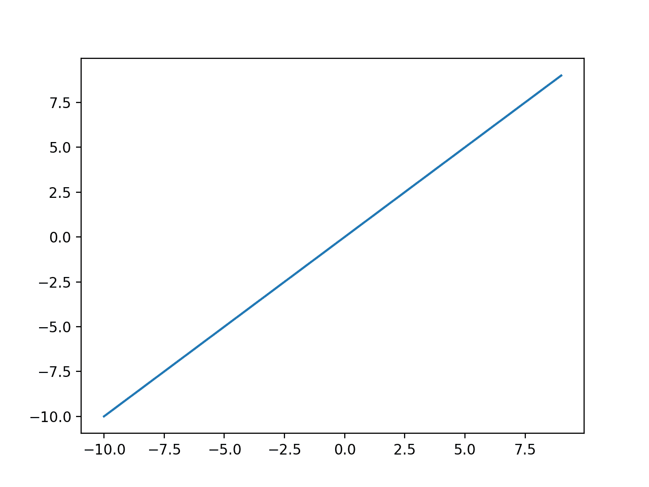
Linear activation function
Linear functions are pretty simple. It returns what it gets as input.

Slide 4
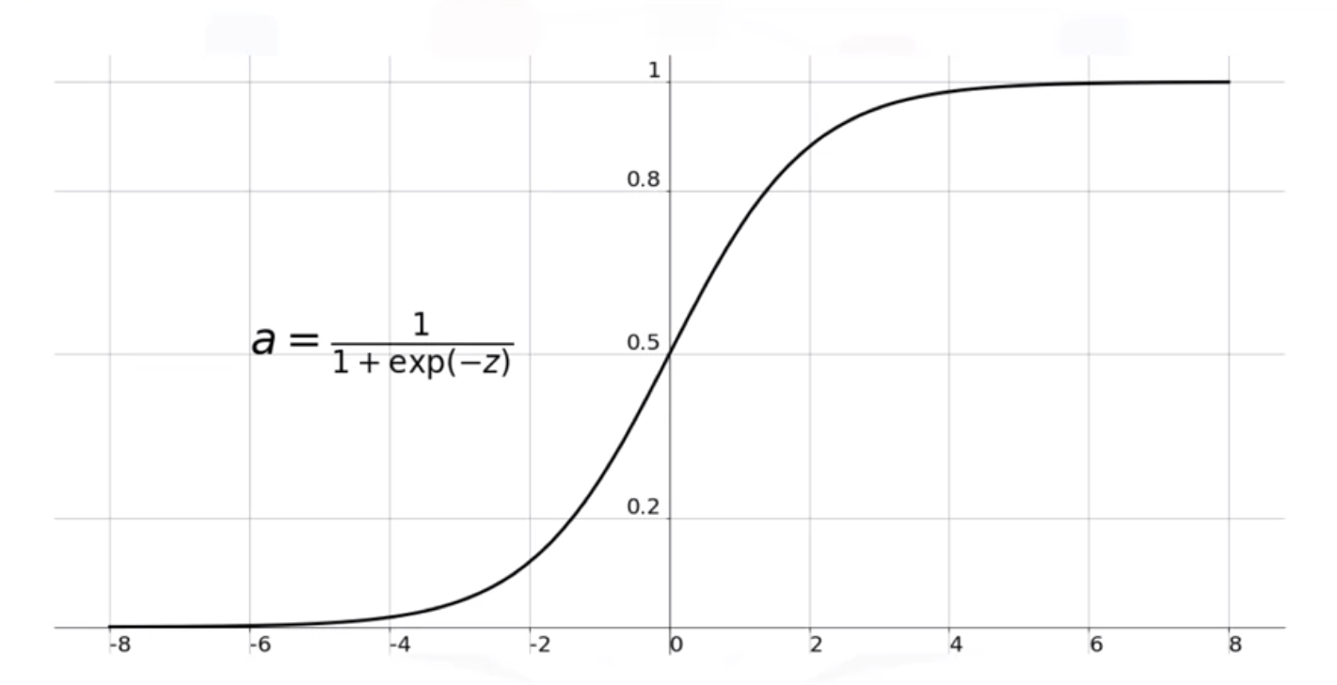
Sigmoid Activation Function
Sigmoid function returns the value between 0.0 and 1.0
Inputs that are much larger than 1.0 are transformed to the value 1.0, similarly, values much smaller than 0.0 are snapped to 0.0
It has a characteristic S-shaped curve

Slide 5
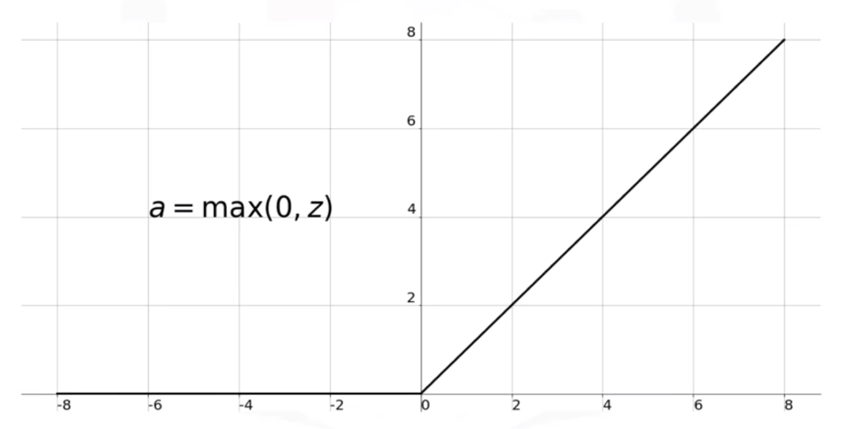
RELU Activation Function
RELU is less computational expensive than the other non linear activation functions
RELU returns 0 if the x (input) is less than 0
RELU returns x if the x (input) is greater than 0

Slide 6
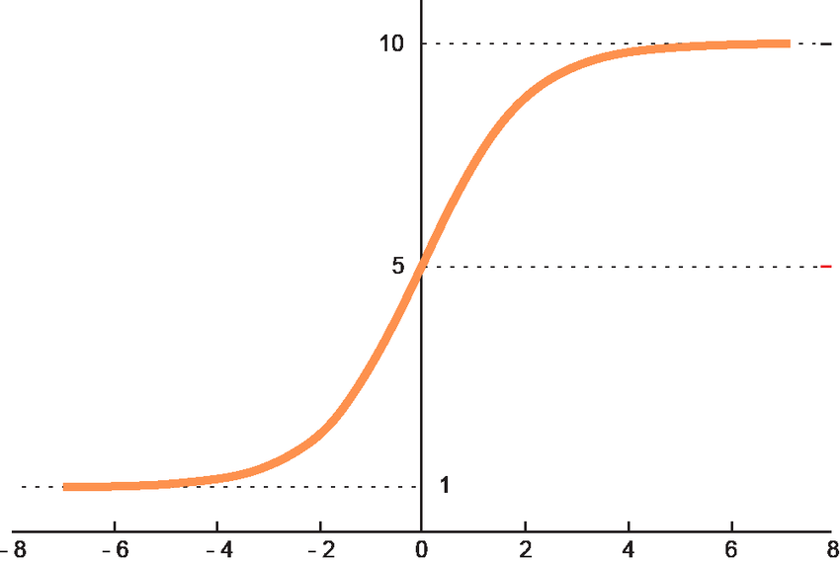
Softmax Activation Function
Softmax turns logits, the numeric output of the last linear layer of a multi-class classification neural network into probabilities
The function is great for classification problems, especially if you’re dealing with multi-class classification problems, as it will report back the “confidence score” for each class

Slide 7
Deep Learning Terminology - 1
Batch & Batch size
The set of examples used in one iteration (that is, one gradient update) of model training.
Batch Size: The number of examples in a batch

Slide 8
Deep Learning Terminology - 2
Batch normalization
Normalizing the input or output of the activation functions in a hidden layer.
Benefits
Make neural networks more stable by protecting against outlier weights.
Enable higher learning rates.
Reduce overfitting.

Slide 9
Deep Learning Terminology - 3
Normalization
The process of converting an actual range of values into a standard range of values, typically -1 to +1 or 0 to 1.
For example, suppose the natural range of a certain feature is 800 to 6,000. Through subtraction and division, you can normalize those values into the range -1 to +1.

Slide 10
—Money
Short bytes – D4
Money management is more important than Money Making

Slide 11
Thanks!
Thanks!
Follow Me on LinkedIn : Link in Description
+91 7305845758
Pantechsolutions.net
Ask Your Friends to Participate on this Event

